Slide 1
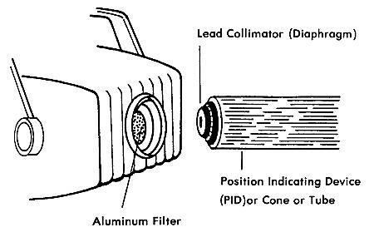
X- ray radiation
10-Aluminum filters of 1-2 mm thickness are used on the
window of the X ray tube head to filter out all the long
wave length X rays from the primary X ray beam.

Slide 2
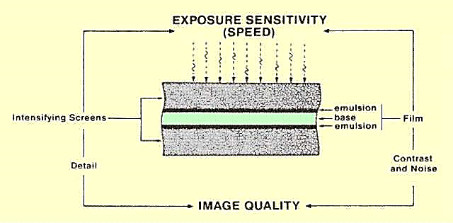
X- ray radiation
10-Use the fastest film screen system compatible
with obtaining diagnostic radiographs

Slide 3
X- ray radiation
11-Use full strength developer and proper solution
temperature to insure that the processing
procedures allow for the use of minimum exposure

Slide 4
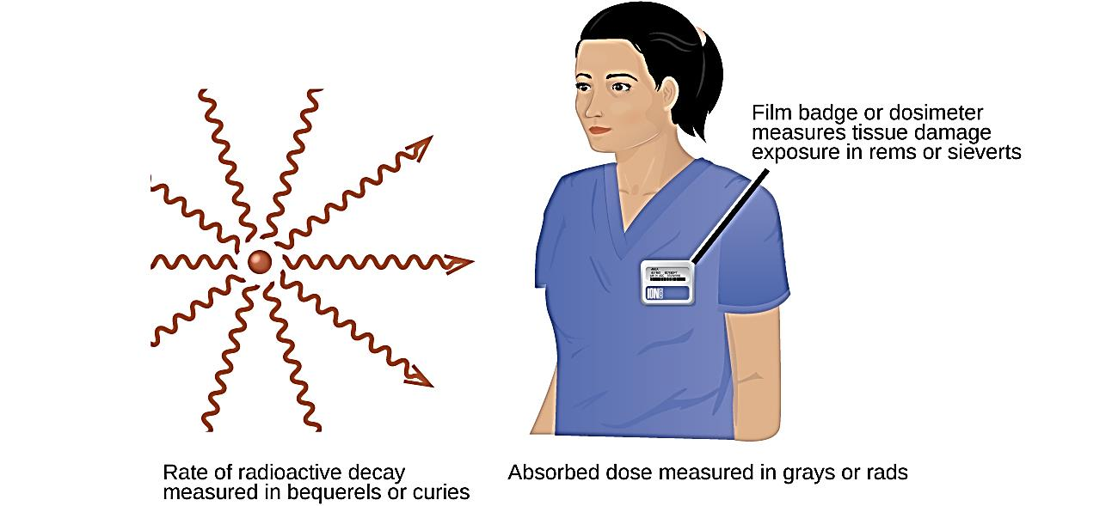
X- ray radiation
12-Always wear film badges.

Slide 5
X- ray radiation
13-Always plan your radiographic procedure
carefully to avoid unnecessary.

